Slide 1
Designing Casanova: a Language for Games
Giuseppe Maggiore, Alvise Spanò, Renzo Orsini, Giulia Costantini, Michele Bugliesi, Mohamed Abbadi
Università Ca’ Foscari di Venezia

Slide 2
Agenda
real time game development challenges
a model for games
language
case study and benchmarks
compiler implementation
future work & conclusions

Slide 3
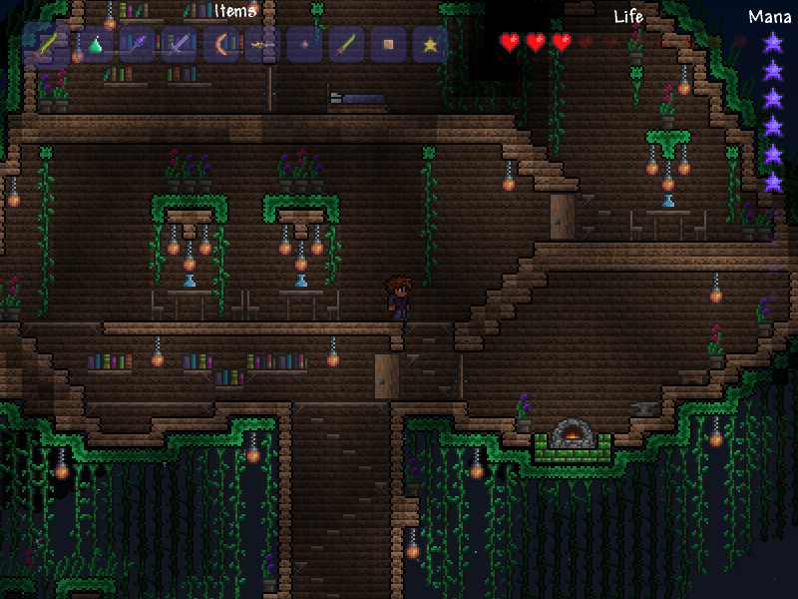

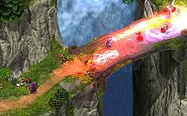
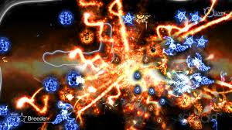
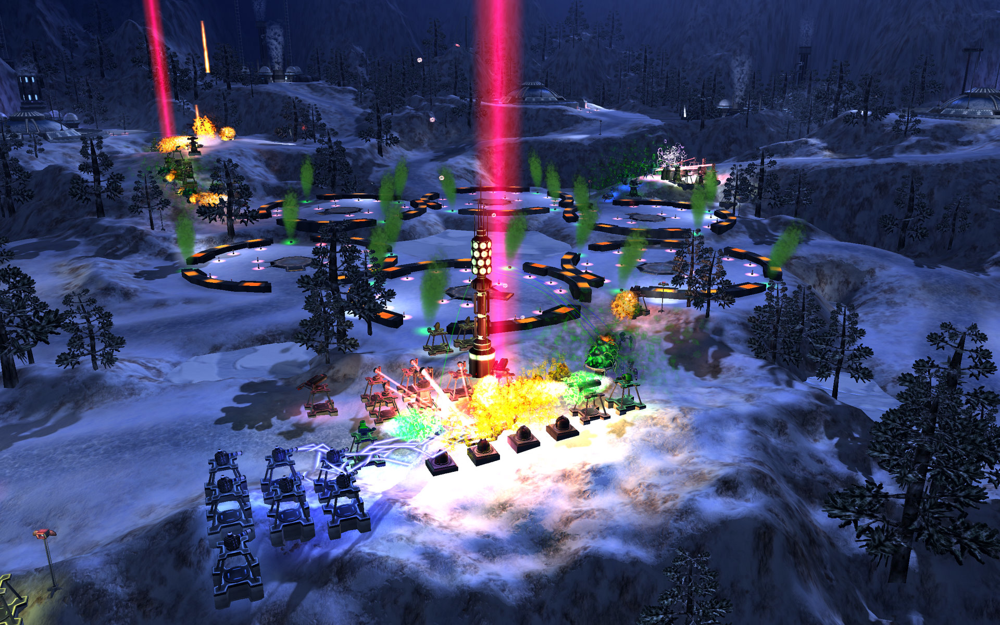
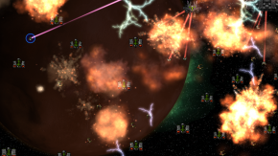
First of all…
…what kind of games?

Slide 4
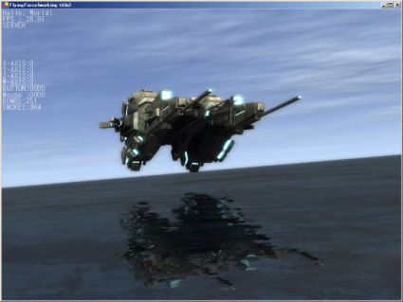
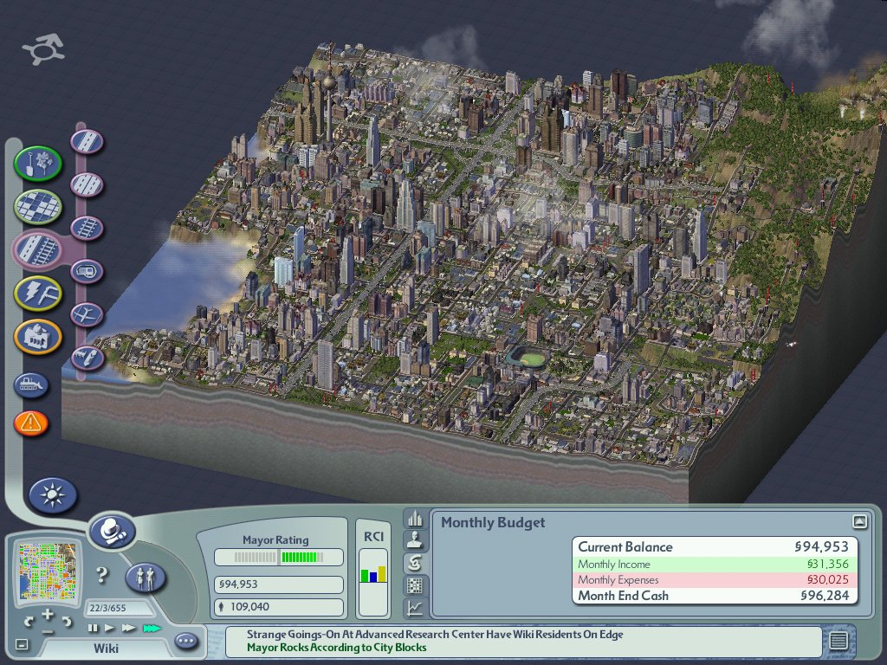
Challenges when making real time games
Performance
Quality
Visual and of the simulation
Development time
Impact of late changes
Game dev. is a creative endeavor

Slide 5
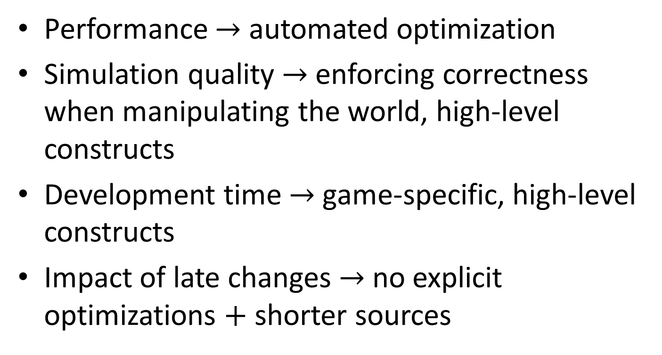
Tackling the Challenges
Performance $→$ automated optimization
Simulation quality $→$ enforcing correctness when manipulating the world, high-level constructs
Development time $→$ game-specific, high-level constructs
Impact of late changes $→$ no explicit optimizations $+$ shorter sources

Slide 6
A Model for Games
A game is
A description of the world
An initial setting
Rules that are constant over time
Behaviors that progress over time

Slide 7
World Description
GameState
Asteroids
Projectiles
Destroyed Asteroids
Missed Asteroids

Slide 8
Initialization
GameState
Asteroids
Projectiles
Destroyed Asteroids
Missed Asteroids

Slide 9
Rules
$$GameState_{t}$$
𝐺𝑎𝑚𝑒𝑆𝑡𝑎𝑡𝑒_𝑡
Asteroids
Projectiles
Destroyed Asteroids
Missed Asteroids
$$GameState_{t+1}$$
𝐺𝑎𝑚𝑒𝑆𝑡𝑎𝑡𝑒_(𝑡+1)
Asteroids
Projectiles
Destroyed Asteroids
Missed Asteroids

Slide 10
Behaviors
spawn
shoot
$$GameState_{t}$$
𝐺𝑎𝑚𝑒𝑆𝑡𝑎𝑡𝑒_𝑡
Asteroids
Projectiles
Destroyed Asteroids
Missed Asteroids

Slide 11
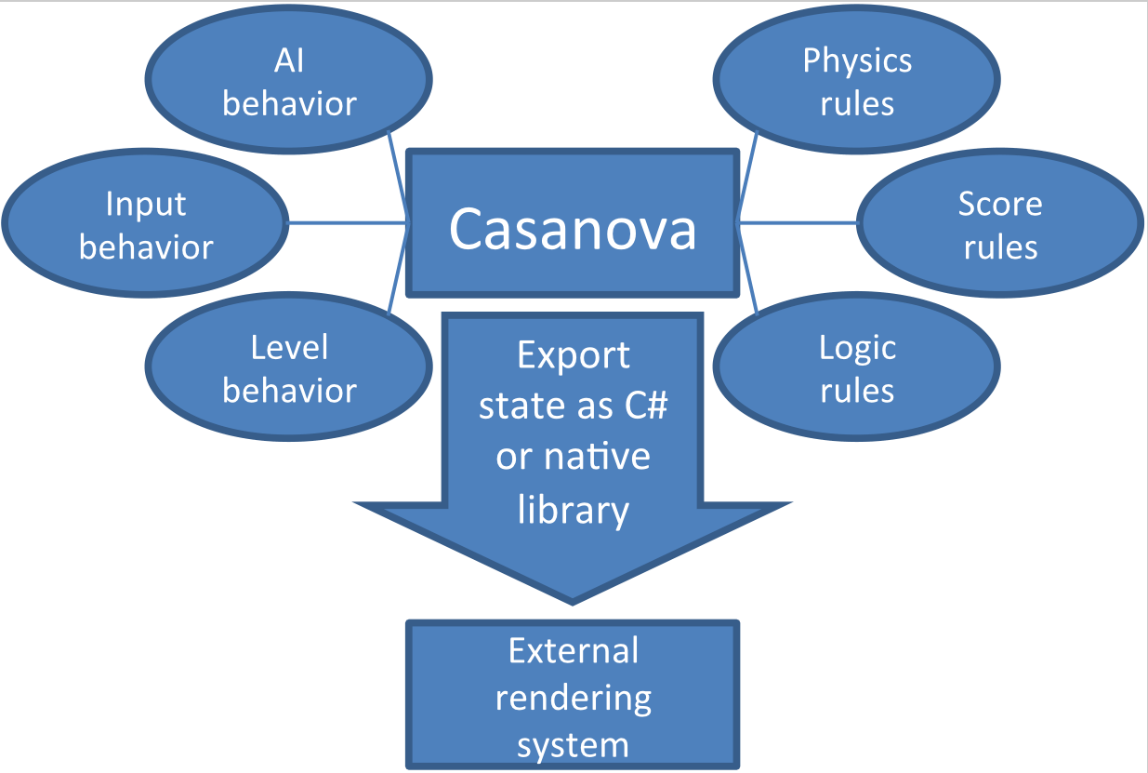
A Model for Games

Slide 12
Sample Source: Asteroid
type Asteroid =
{
rule Y : float =
fun (state,self,dt) -> self.Y + dt * self.VelY;
VelY : float;
X : float;
rule Colliders : Table<Projectile> =
fun (state,self,dt) ->
[p | p <- state.Projectiles, collides p self]
}

Slide 13
Sample Source: Projectile
type Projectile =
{
rule P : Vector2 =
fun (state,self,dt) -> self.P + dt * self.V;
V : Vector2;
rule Colliders : Table<Asteroid> =
fun (state,self,dt) ->
[a | a <- state.Asteroids, collides a self]
}

Slide 14
Sample Source: Game State
type GameState =
{
rule Asteroids : Table Asteroid =
fun (self,dt) ->
[a | a <- self.Asteroids && a.Y > 0
&& a.Colliders.Length = 0];
rule Projectiles : Table Asteroid =
fun (self,dt) ->
[p | p <- self.Projectiles && p.Y < 100
&& p.Colliders.Length = 0];
rule CannonAngle : float =
fun (self,dt) -> self.CannonAngle + dt * is_key_down(Left)
– dt * is_key_down(Right)
…

Slide 15
Sample Source: Game State
rule DestroyedAsteroids : int =
fun (self,dt) ->
let asts = [a | a <- self.Asteroids && a.Y <= 0]
self.DestroyedAsteroids + asts.Length;
rule MissedAsteroids : int =
fun (self,dt) ->
let asts = [a | a <- self.Asteroids &&
a.Colliders.Length > 0]
self.MissedAsteroids + asts.Length;
}

Slide 16
Sample Source: Initial State
let state0 =
{
Asteroids = []
Projectiles = []
MissedAsteroids = 0
DestroyedAsteroids = 0
}

Slide 17
Sample Source: Spawn Asteroids
let main state =
let rec spawn_asteroids() =
{
do! wait (random(1.0,3.0))
state.Asteroids.Add
{
X = random(-1.0 ,+1.0)
Y = 1
VelY = random(-0.1,-0.2)
Colliders = []
}
if !state.MissedAsteroids < 100 then
do! spawn_asteroids ()
else
return () }
…

Slide 18
Sample Source: Shoot Projectiles
…
let rec shoot_projectiles() =
{
if key_down(Keys.Space) then
state.Projectiles.Add(
{
P = Vector2(0.0,0.0)
V = Vector2(cos(state.CannonAngle),sin(state.CannonAngle))
Colliders = []
}
if !state.DestroyedAsteroids < 100 then
do! shoot_projectiles()
else
return () }
…

Slide 19
Sample Source: Main
…
in spawn_asteroids() ||
spawn_projectiles()

Slide 20
Casanova Sample Source
DEMO

Slide 21
Optimizations
Double buffering for rules
Rule<‘a> = { Current : ‘a; Next : ‘a }
Parallel processing of rules over tables
Query optimization

Slide 22

Query Optimization
Indices for collision/logical queries
[a | a <- state.Asteroids, collides a self]
$O\left(n^{2}\right)→O(n)$

Slide 23
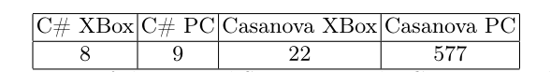

Case Study and Benchmarks
Xna asteroids game (without rendering)
Casanova $→$ ~300 LOCs
C# $→$ ~1000 LOCs

Slide 24
Case Study and Benchmarks
Galaxy Wars DEMO

Slide 25
Compiler Implementation
Various Casanova libraries are already part of Galaxy Wars
(open source at vsteam2010.codeplex.com)
We are building a fully fledged compiler
Targeting F# and Xna
(open source at casanova.codeplex.com)

Slide 26
Compiler Implementation
Parsing, type checking and type inference are working
Code generation still lacks some optimizations
The two are not yet integrated ☹
But they will soon be ☺

Slide 27
Final remarks
Advantages over existing languages
Knows about games
Concise
Knows about time
Consistent updates to the state
Behaviors (coroutines) as a first class construct
Focus on the game, not the optimizations

Slide 28
Future Work
Rendering
Networking
AI Skeletons
More optimizations
Reference counting (i.e. Xbox)
Structs of array VS arrays of structs
Coroutines as SMs
…

Slide 29
References
Monadic Scripting in F# for Computer Games
A compilation technique to increase X3D performance and safety
Friendly F#, fun with game development and Xna

Slide 30
This is it! Thank you!
vsteam2010.codeplex.com casanova.codeplex.com giuseppemag@gmail.com

